Slide 1
US_Birth Analysis

Slide 2
Contents :
Case Study
Objectives
Data Analysis
Findings and Scope of improvements

Slide 3
Case Study:
The data consists of 5000+ rows contains number of child born in United States from year 2016 to 2021.
Worksheet contains details such as States, Year, Gender of baby, Average age of mother, Education level of mother, Number of Births and Average weight of baby.

Slide 4
Objectives and Analysis:
Find out Birth_ratio YOY and Top 10 states in recent year 2021.
Segregate Average age of mother into groups and find out in which category has highest birth_ratio.
Find out birth_ratio according to Education level of mother.
Find out ratio for healthy or low weight babies.
Categories age of mother and health of baby.
To identify mother education level and age must be appropriate to give a birth.

Slide 5
Categorization
Average_Age_of_Mother | Average_Birth_Weight_gm
Early Age Mother (23.1 – 28.4) | Low Weight Baby (1500 - 2700)
Middle Age Mother (28.4 – 30.8) | Healthy Baby (>=2700)
Matured Age Mother (30.8 – 35.5)

Slide 6
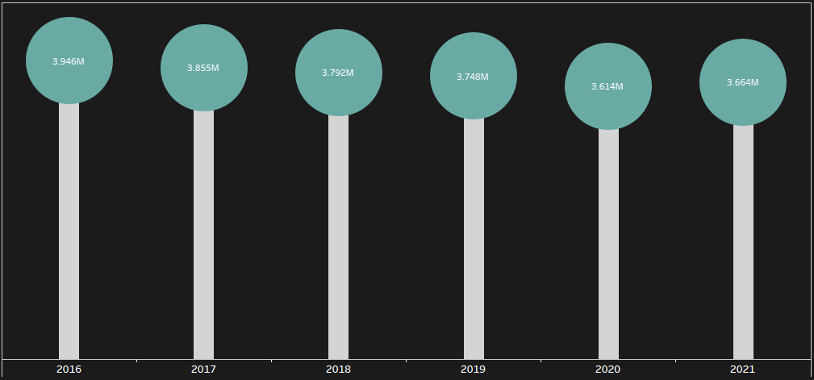
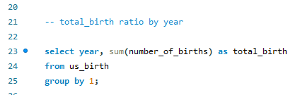
Birth Ratio by YOY
As we can see number of births are continuously dropping but there is major fall in Year 2020 and again start increasing in year 2021.

Slide 7
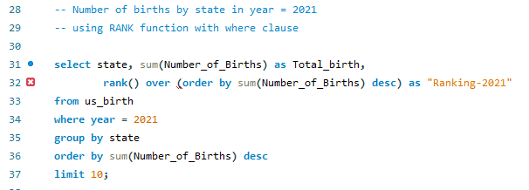
Top 10 States (in 2021)
Here are Top-10 states which has highest number of births in recent year 2021.

Slide 8

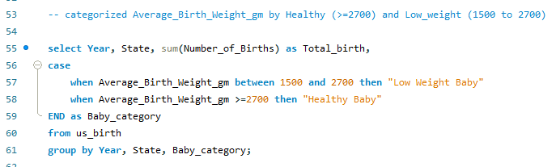
Categorized Average_Birth_Weight_gm
Categorized Average_Birth_Weight_gm by Healthy (>=2700) and Low_weight (1500 to 2700)
Conspicuously we have negligible number of Low weight babies, which is excellent.

Slide 9
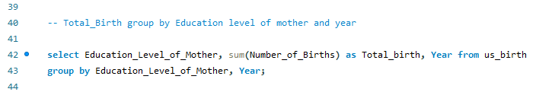
Birth_Ratio by Education level of mother
High School graduates or GED completed has Highest birth_ratio.
Bachelor’s Degree has second highest birth_ratio followed by category not a degree.
We have less birth_ratio in category of well qualified mothers.(Master’s degree, doctorate or professional degree). Who are enough capable for sustenance of a child.

Slide 10
Categorized Age_of_mother
Majority of mothers are from early age category (23.1 – 28.4)- 46.45%.
Then middle age category (28.4 – 30.8) occupies 22.56% and matured age category (30.8 – 35.5) occupies 30.99%.

Slide 11
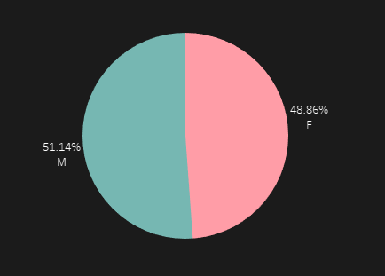
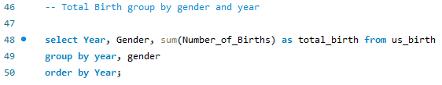
Birth_ratio by Gender
Both gender have very minor difference.
Female : 48.86%
Male : 51.14%

Slide 12
Findings And Scope of Improvement:
We have drastic fall in number of births in year 2020.
California have highest number of births in year 2021 which is 421K.
We have excellent ratio of healthy babies.
Birth_ratio is very low in category of well qualified mothers.(Master’s degree, doctorate or professional degree). Who are enough capable for sustenance of a child.
Majority of mothers are from early age category (23.1 – 28.4)- 46.45%.
Birth_ratio based on gender is also wonderful.

Slide 13
Applications used for analysis:
SQL Workbench: used for data analysis and derive meaningful information
Tableau: used for Graphical Representation of data
PowerPoint: used for describing findings and scope of improvement in presentation manner

